Slide 1

Food Security Monitoring Tool for Karamoja Uganda.
Sammy Murumwa

Slide 2

O
?
Research Questions
What is the exact location of Karamoja region in Uganda on Map?
Which districts have dedicated more land to farming of Maize and Sorghum?
What percentage of the total yield production per Subcounty?
What are the distribution of yieds across the districts and Subcounties?

Slide 3
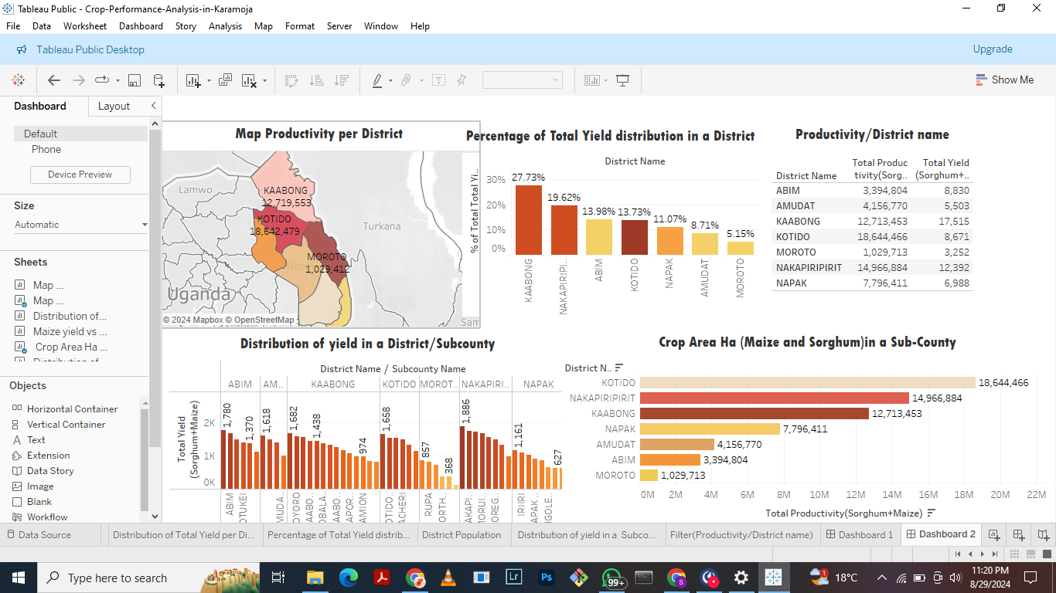


Slide 4
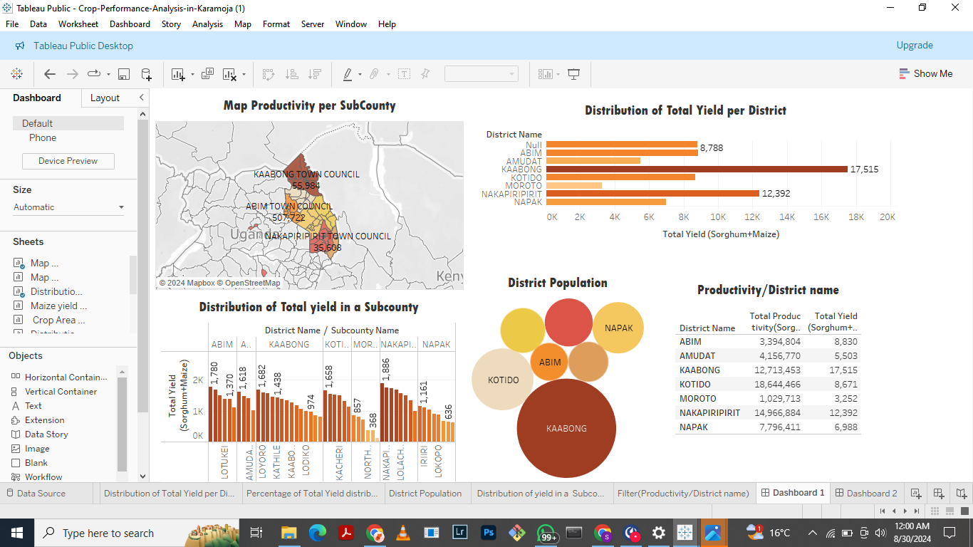


Slide 5
Conclusion
Low Maize Yield in Certain Sub-Counties
Uneven Distribution of Crop Yields Across Districts
High Concentration of Sorghum Farming
Recommendations
Low Maize Yield in Certain Sub-Counties
Uneven Distribution of Crop Yields Across Districts
High Concentration of Sorghum Farming

Slide 6
THANK YOU

